Slide 1

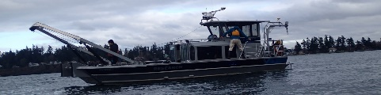

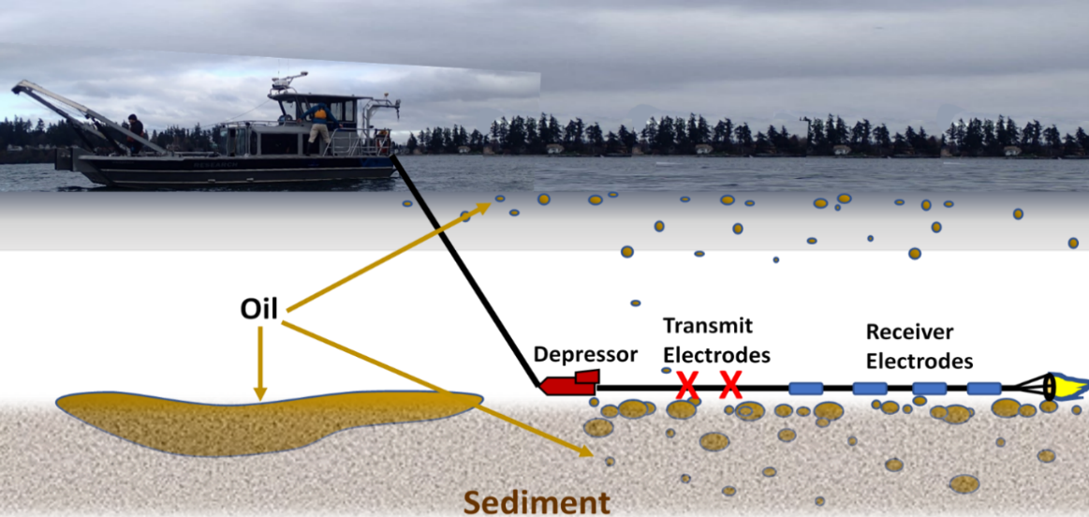
ADAC Annual Meeting
Marine IP - Detection and Mapping of Oil Under Ice: A Ruggedized Field Kit
Researcher Kari Walker, IntelliSense Marine LLC
PI Dr. Scott Socolofsky, Texas A&M University

Slide 2
ADAC Project: Marine Induced Polarization Methods for the Detection and Mapping of Oil in an Arctic Marine Oil Spill – Ruggedized Field Kit Production and Testing
ADAC Annual Meeting: 03 June 2021
• Project Principal Investigator: Dr. Scott Socolofsky, Texas A&M University
• Supporting Team:
  Ms. Kari Walker and Mr. Kevin Hand, IntelliSense Marine
  Mr. Art Wright, Mr. Jay Radler and Mr. Todd Stedman, Induced Polarization Associates
  Mr. Nathan Lamie, Lead Engineer/Facility Operator, Cold Regions Research and Engineering Laboratory, U.S. Army Corps of Engineers
• Project Champion: LCDR Clifton Graham, CG-MER

Slide 3
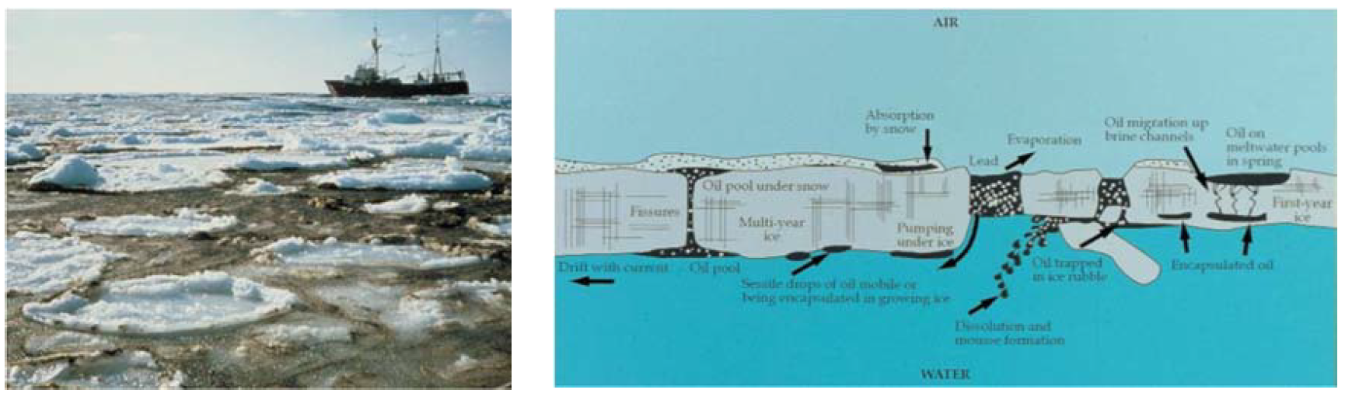
Marine IP: Project Description and Baseline
ADAC Annual Meeting: 03 June 2021
Project Description: Federal on-scene spill responders need remote sensing tools to detect and map oil in the open-Arctic ocean, broken ice fields, as well as oil under and within ice.
This research effort will build and test hardware and software for an Arctic-Ready Marine Induced Polarization (Marine IP) System, which locates and assesses polarizable mineral and particle distributions - such as hydrocarbons - in water, ice and in sediment.
Baseline: Marine IP has shown strong promise to serve as a tool for the detection and mapping of oil under ice and in seafloor sediment. A robust, Arctic-Ready Marine IP system needs to be developed to mitigate the harsh conditions of the Arctic.

Slide 4
Marine IP: Method
ADAC Annual Meeting: 03 June 2021
Oil on and within seafloor sediment:
A cable is towed behind a vessel
Transmit electrodes emit a controlled electrical current
Receiver electrodes measure changes in the return signal caused by substances encountered
Oil
Transmit Electrodes
Receiver Electrodes
Depressor

Slide 5
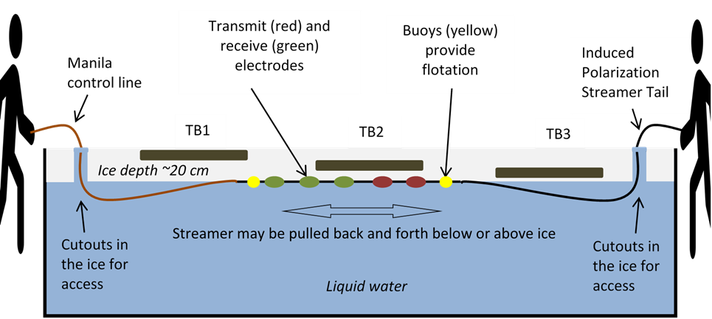
Marine IP: Method
ADAC Annual Meeting: 03 June 2021
Oil-Under-Ice testing: CRREL Testing Facility
A cable streamed under tank ice
Transmit electrodes emit a controlled electrical current
Receiver electrodes measure changes in the signal due to substances encountered
Transmit (red) and receive (green) electrodes
Induced Polarization Streamer Tail
Induced Polarization Streamer Tail
Buoys (yellow) provide flotation
Control line
Test Area
Test Area
Test Area
Water at 0.25 Salinity

Slide 6
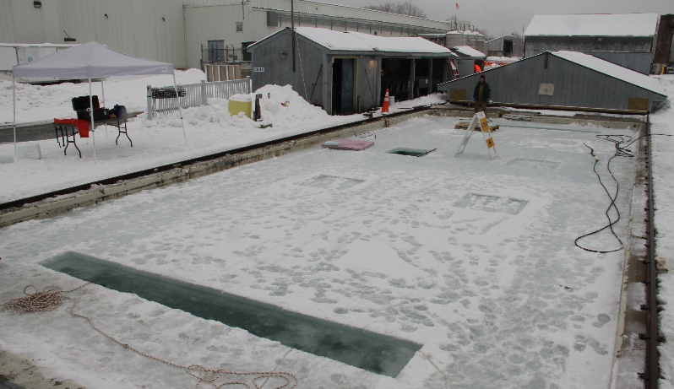
Marine IP: Method
ADAC Annual Meeting: 03 June 2021
CRREL Testing Facility
Oil-Under-Ice testing: CRREL Testing Facility:
Tests will be conducted using shared oil under ice conditions:
  Existing oil placement will be well documented
  Additional oil will be added under and encapsulated within the ice
Transmit (red) and receive (green) electrodes
Induced Polarization Streamer Tail
Buoys (yellow) provide flotation
Control line
Test Area
Test Area
Test Area
Water at 0.25 Salinity

Slide 7
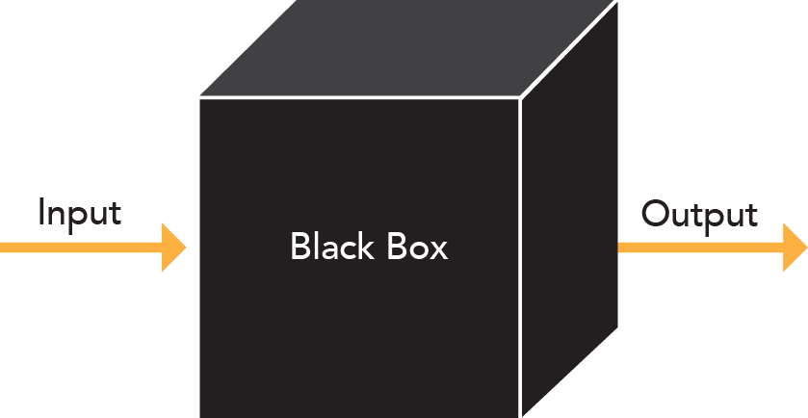
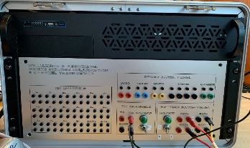
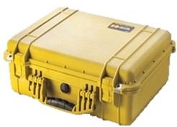
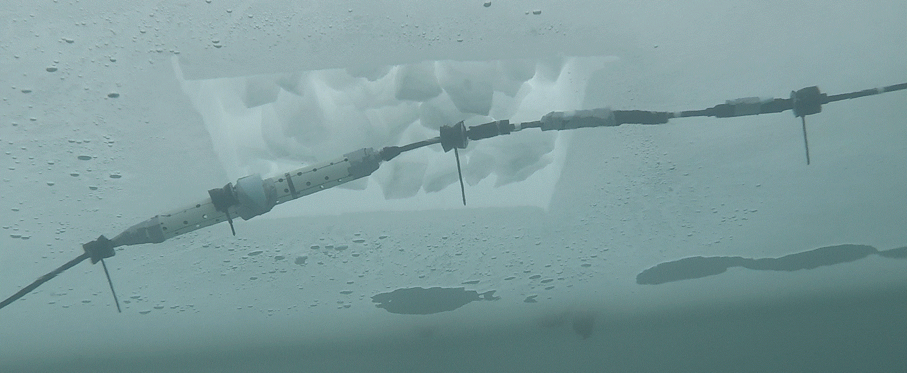
Marine IP: Progress on Research Objectives
ADAC Annual Meeting: 03 June 2021
Project Objectives:
Continue to validate Marine IP as a viable means to detect oil within ice and broken ice: Y8, no-cost extension due to COVID-19 delays
Develop and build the hardware, firmware and software for an Arctic-Ready Marine IP System that can withstand the harsh environment of the Arctic: Y8, no-cost extension
Test the Arctic-Ready Marine IP System in an offshore, towed scenario: Y8, no-cost extension
Test the Arctic-Ready Marine IP System in a simulated Arctic environment scenario (CRREL): Y8, no-cost extension
Further identify possible Marine IP deployment mechanisms for characterization, with emphasis on AUVs: June 30
Old Enclosure
New Enclosure

Slide 8
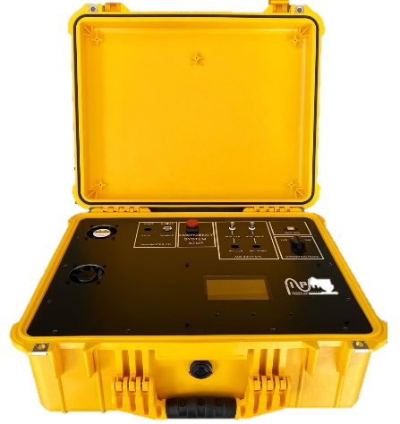
Marine IP: Progress on Remaining Year 6 Objectives
ADAC Annual Meeting: 03 June 2021
Old System
Remaining Project Objectives:
Investigate the potential of Marine IP to detect oil in partial ice formations as well as under pack ice.
Investigate and determine Marine IP’s effectiveness to accurately detect the extent of contaminated areas.
Remaining Project Milestones:
Determine the spectral signature of selected target contaminants utilizing a Marine IP system.
Complete data analysis and reporting.
New System

Slide 9
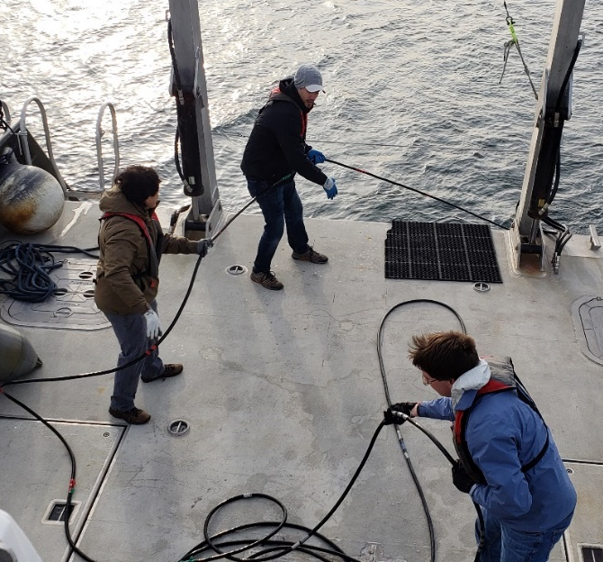
Marine IP: Planned Field Work
ADAC Annual Meeting: 03 June 2021
Delayed to Year 8 – No-cost extension due to COVID-19
Oil-Under-Ice testing: CRREL Testing Facility
Tests using shared oil under ice conditions:
Open Water Testing: Puget Sound
Tests on a vessel in Puget Sound, WA:
CRREL Testing Facility

Slide 10
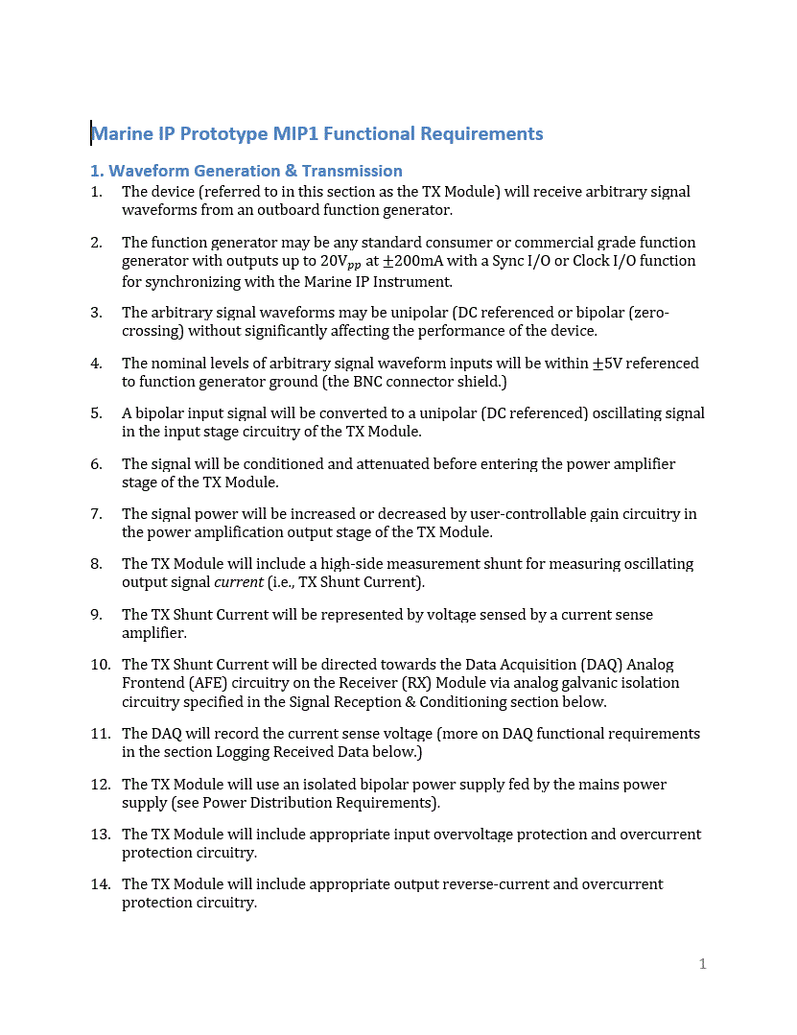
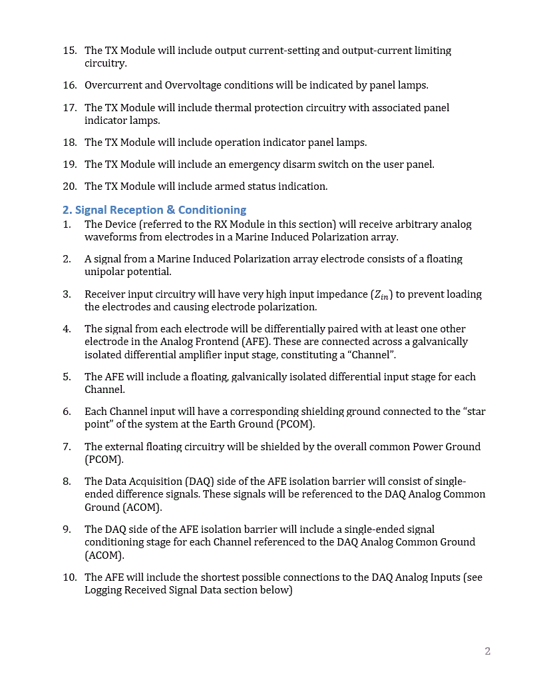
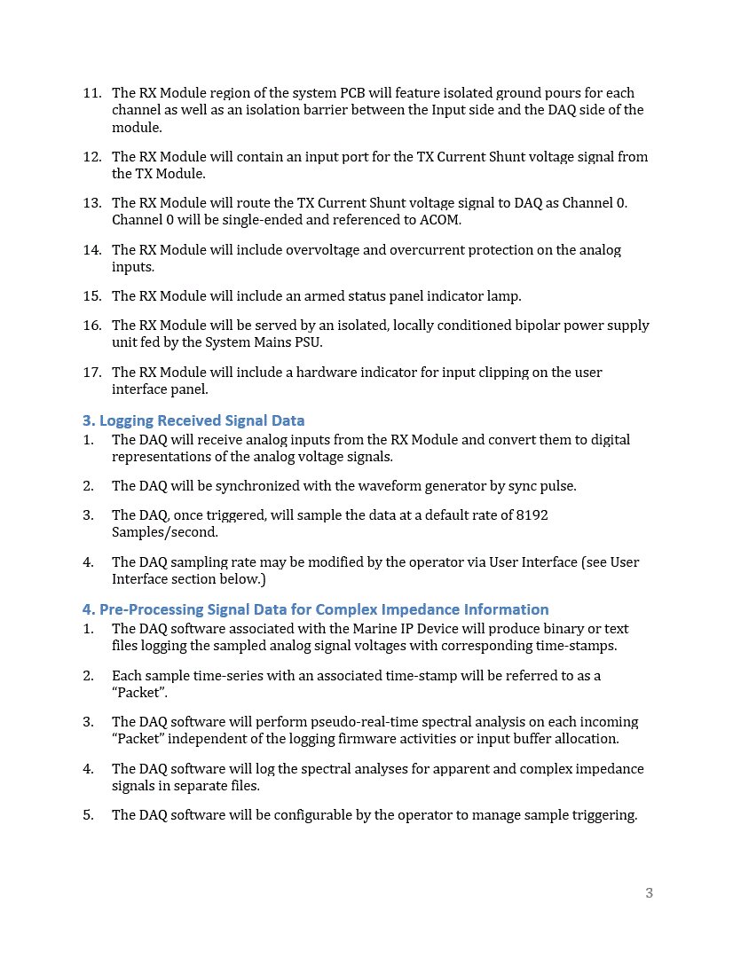
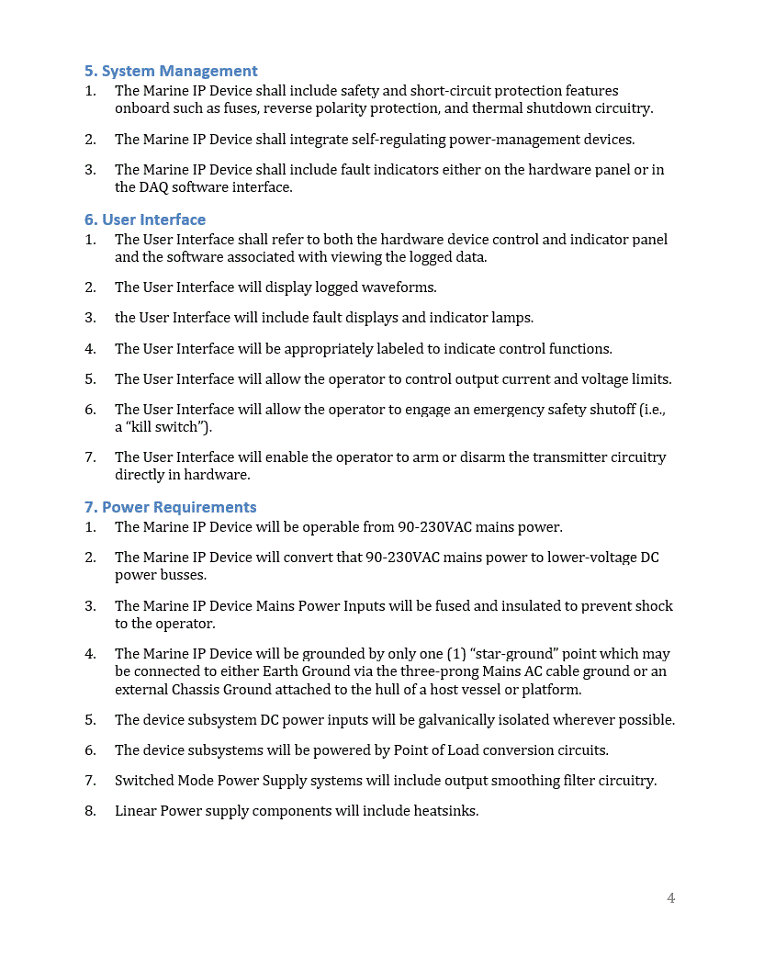
Marine IP: Progress on Milestones
ADAC Quarterly Review: 29 Apr 2021
Project Milestones – Hardware Design
Outline of general design requirements. Complete

Slide 11
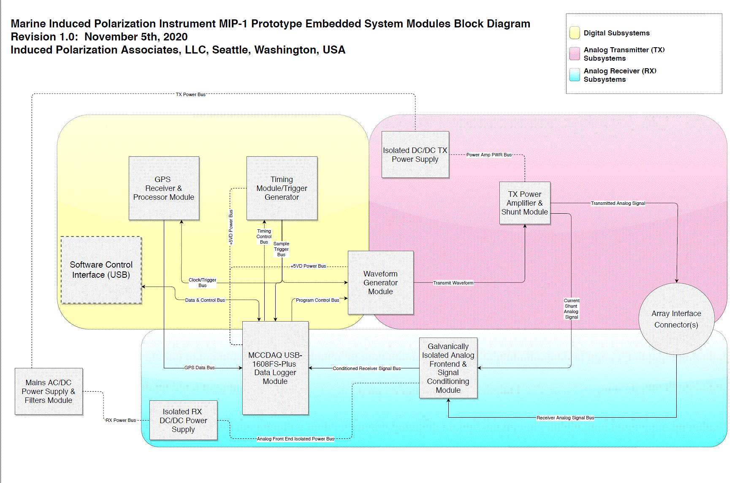
Marine IP: Progress on Milestones
ADAC Annual Meeting: 03 June 2021
Project Milestones – Hardware Design
High-level block diagrams for device prototype. Complete

Slide 12
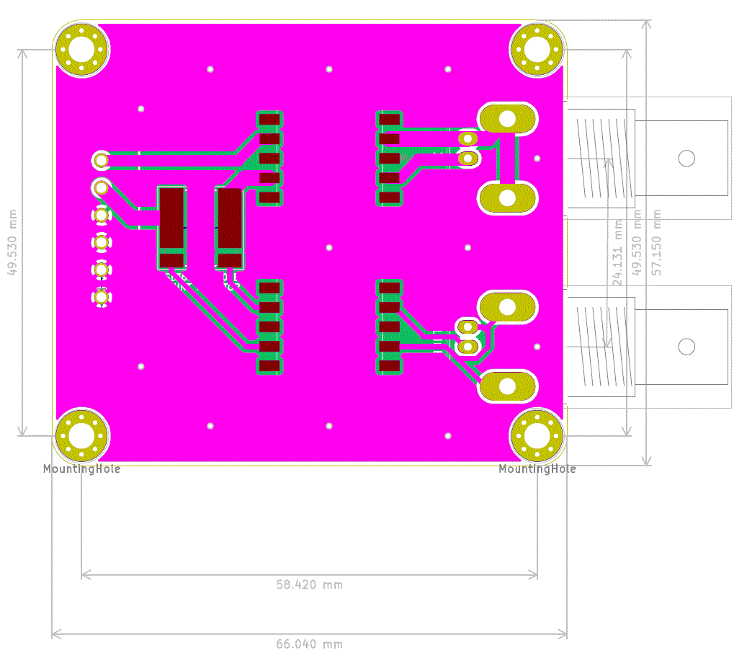
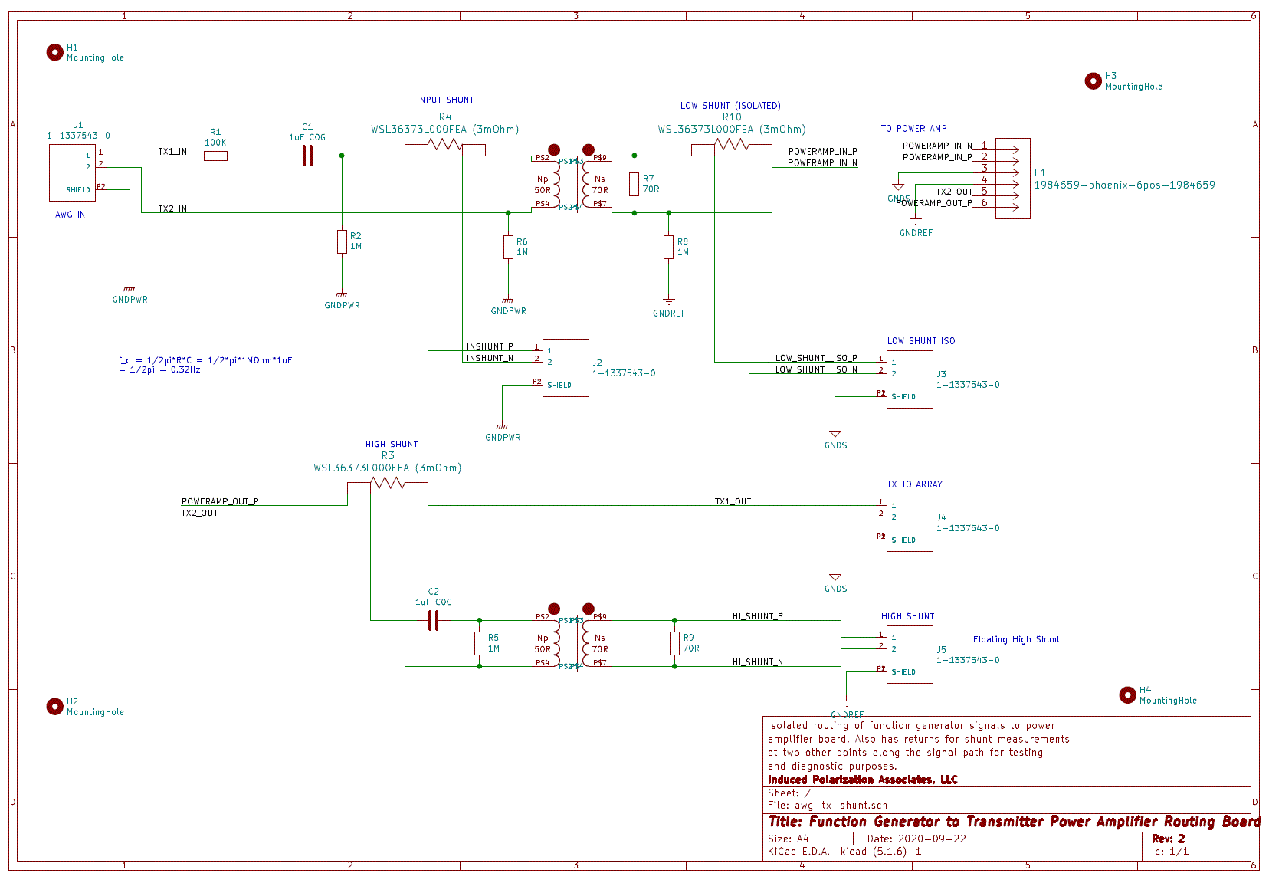
Marine IP: Progress on Milestones
ADAC Annual Meeting: 03 June 2021
Project Milestones – Hardware Design
Laboratory testing device design drawings. Complete

Slide 13
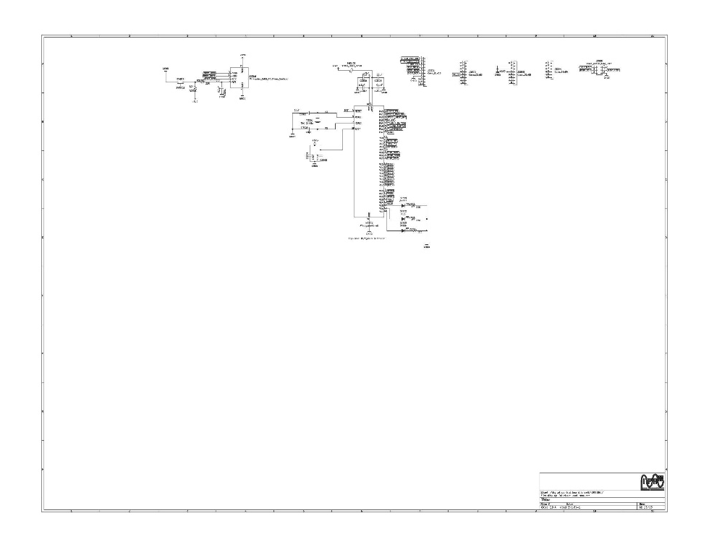
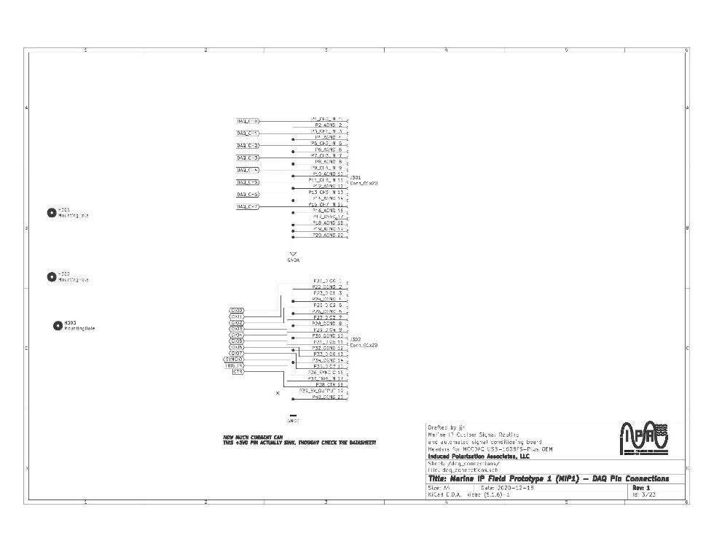
Marine IP: Progress on Milestones
ADAC Annual Meeting: 03 June 2021
Project Milestones – Software Design
Engineering report outlining requirement and specification details. Complete
Develop a plan-design-implement-test-revise loop. Complete
Select a suite of core usage and testing cases. Complete

Slide 14
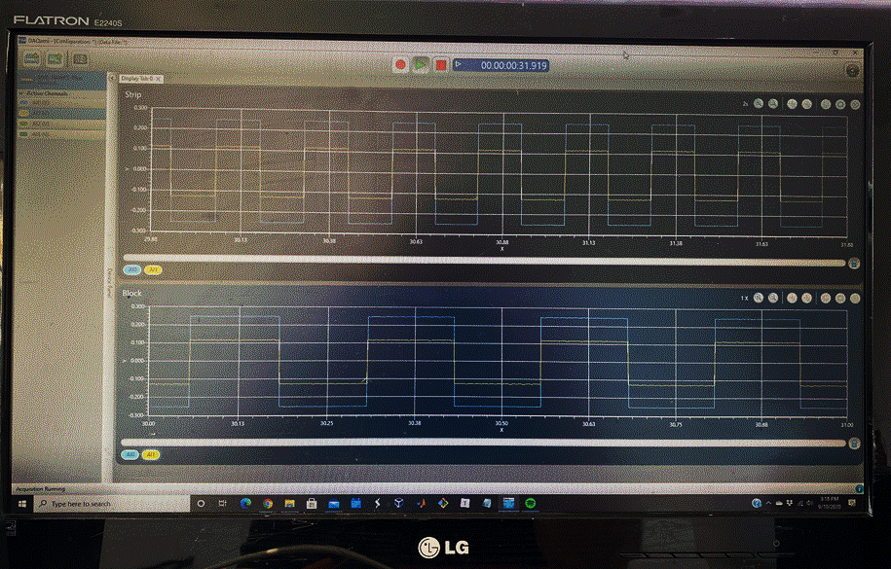
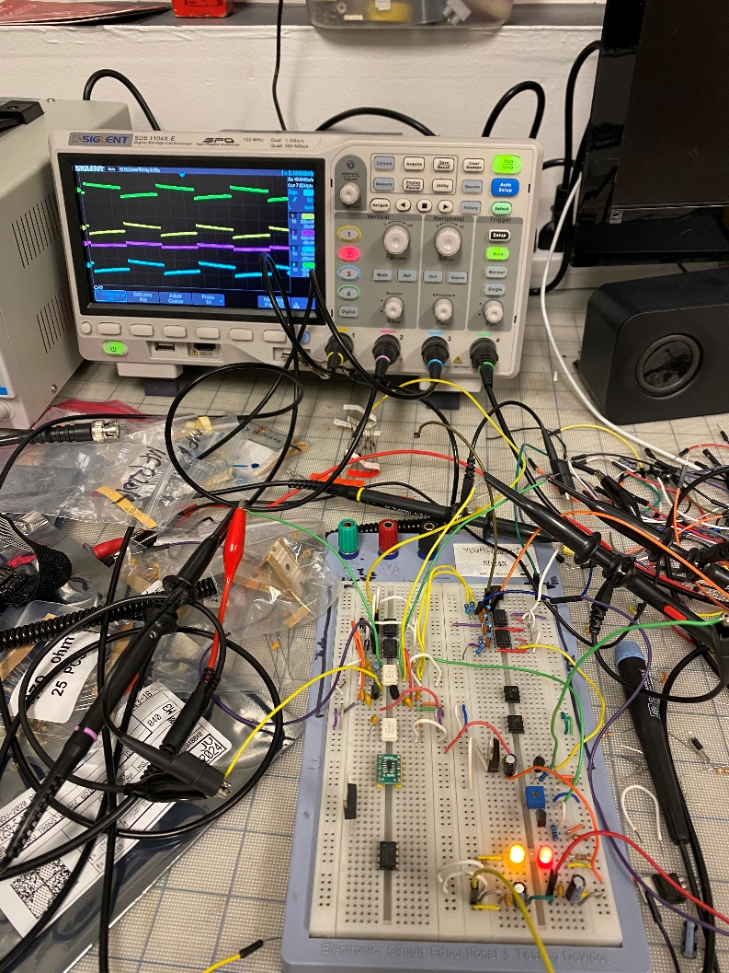
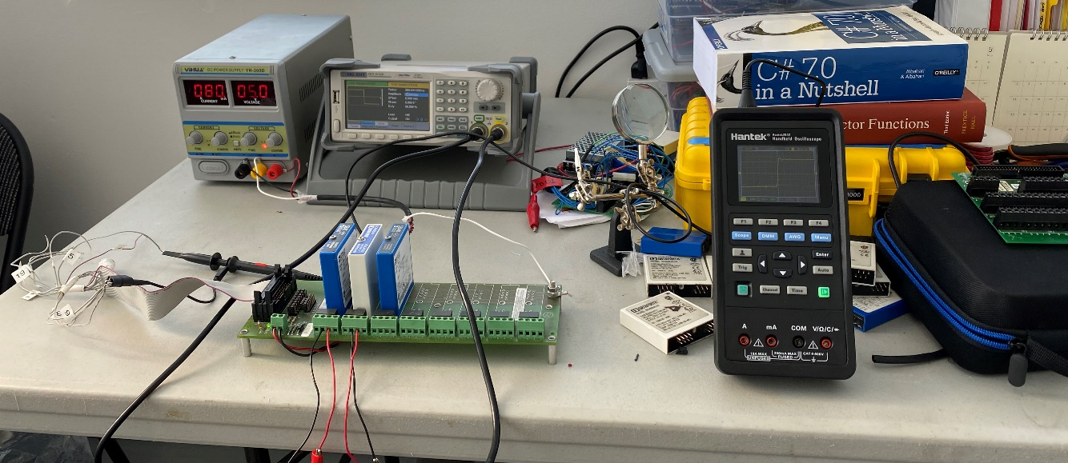
Marine IP: Progress on Milestones
ADAC Annual Meeting: 03 June 2021
Procure and test components for functional performance in the laboratory on small-scale. Complete

Slide 15
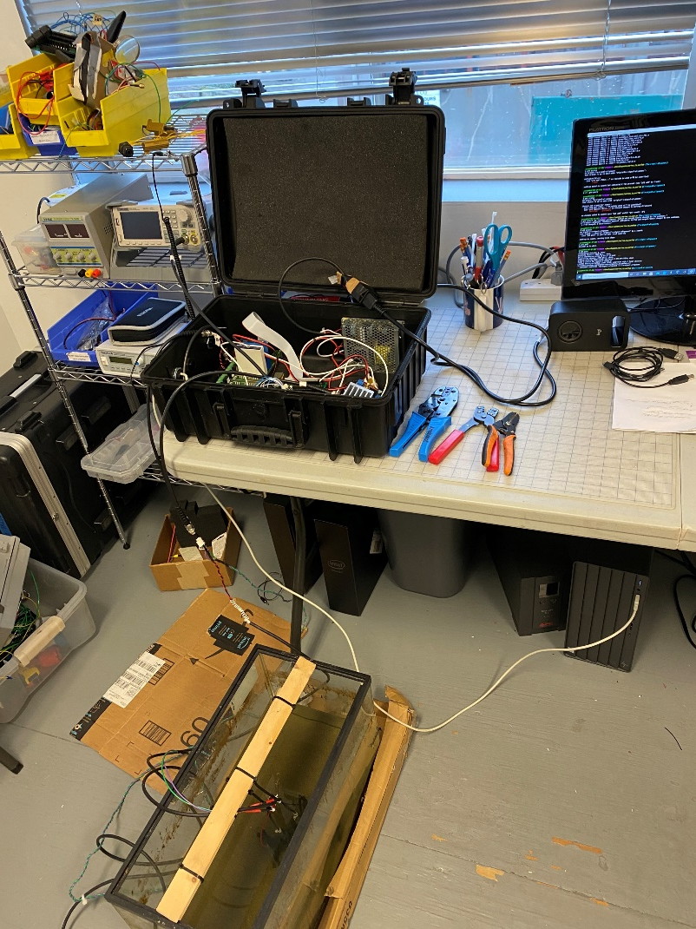
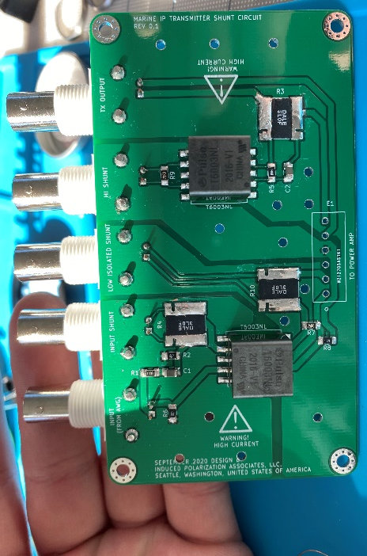
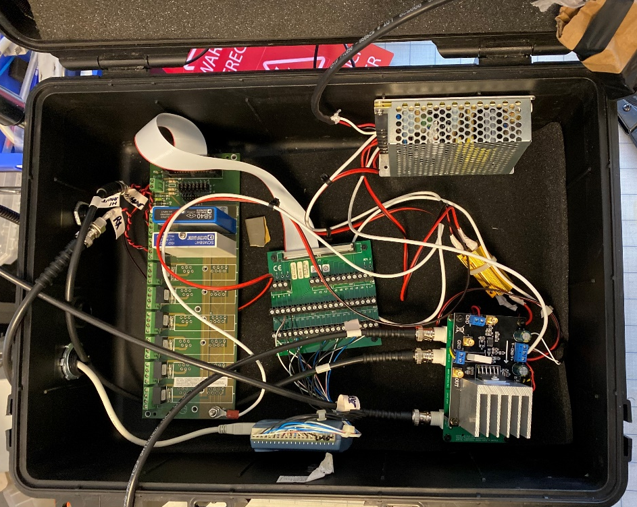
Marine IP: Progress on Milestones
ADAC Annual Meeting: 03 June 2021
Complete any preliminary revisions to hardware design based on laboratory tests of components. Complete

Slide 16
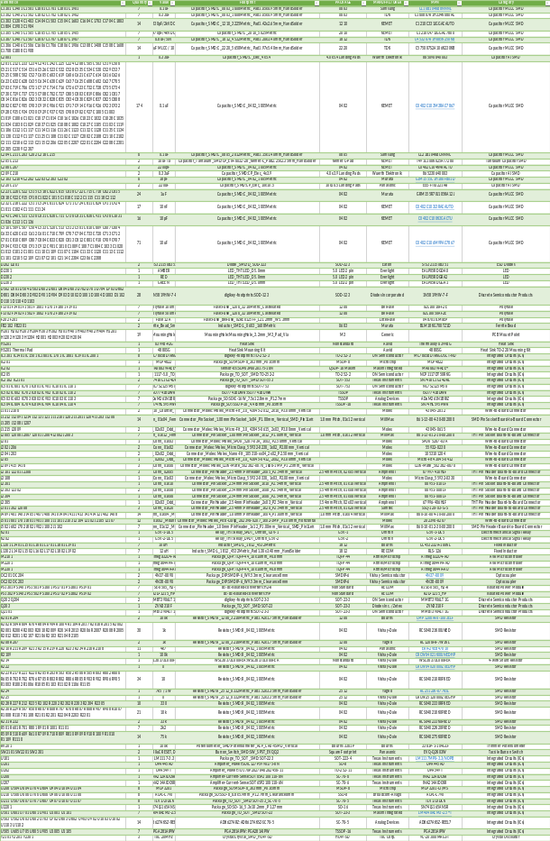
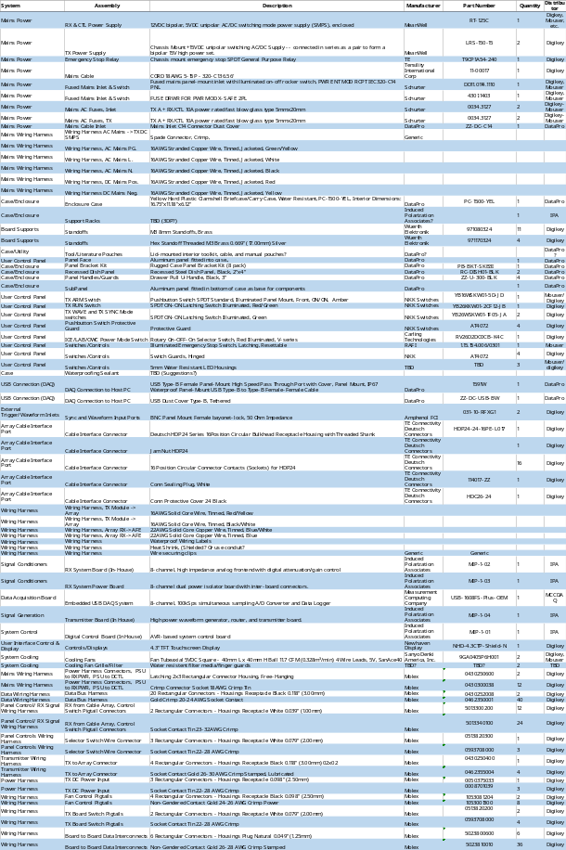
Marine IP: Progress on Milestones
ADAC Annual Meeting: 03 June 2021
Assemble Bill of Materials. Complete
PCB and Offboard BOMs

Slide 17
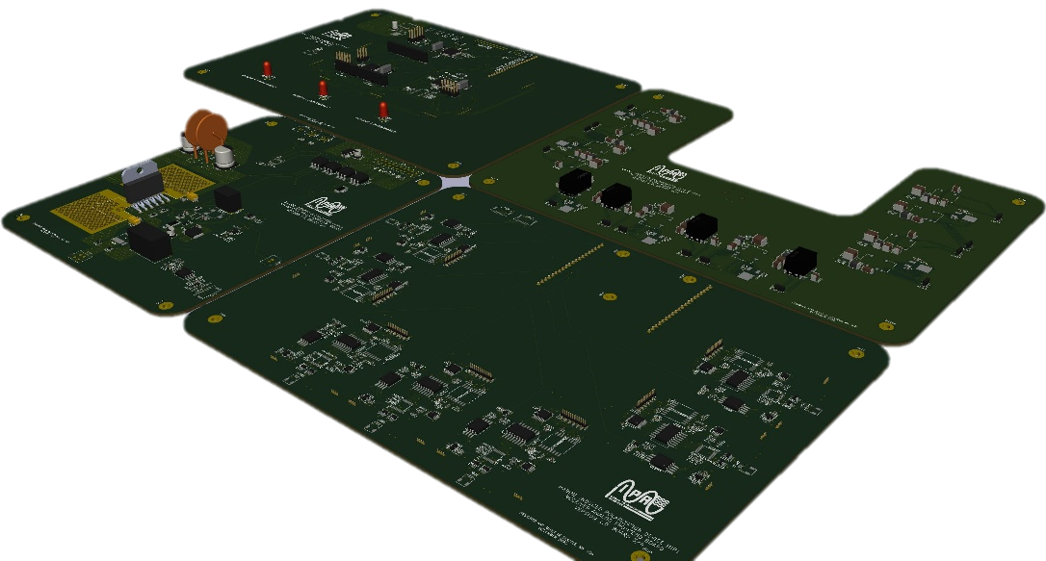
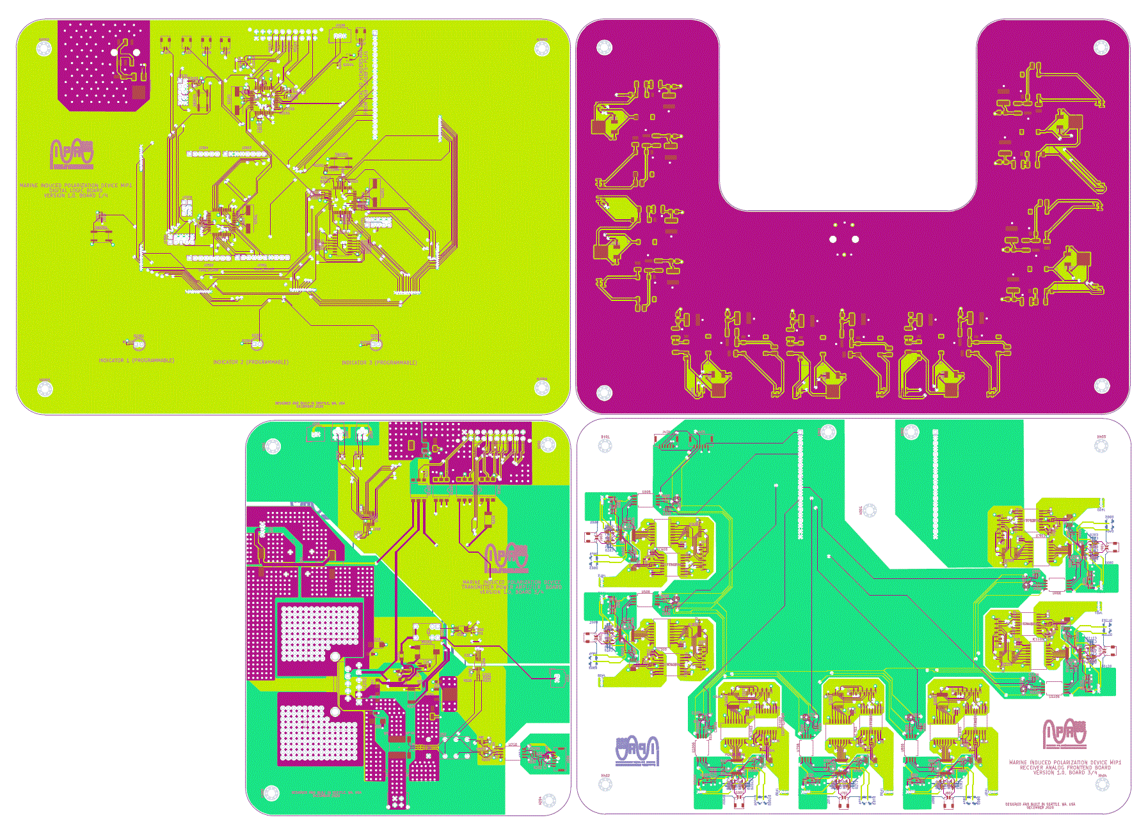
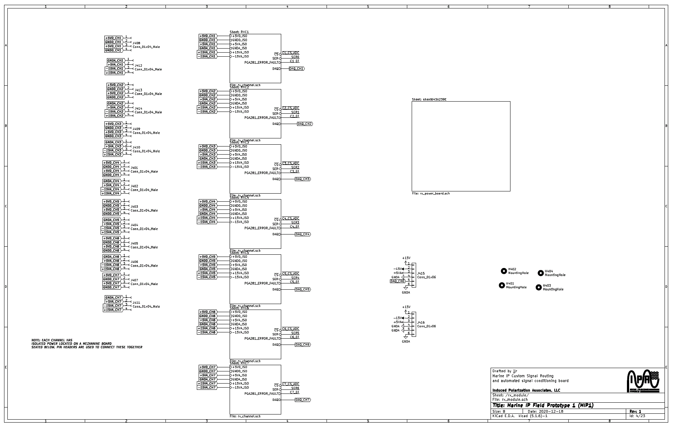
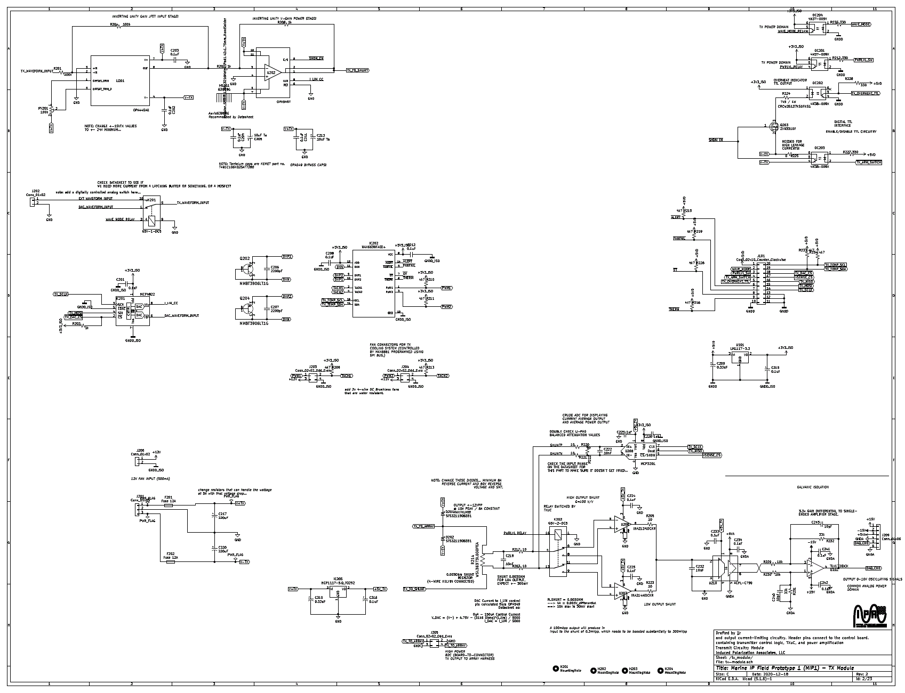
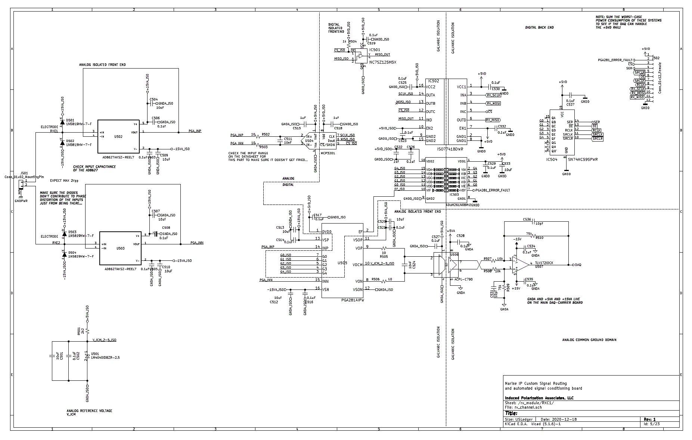
Marine IP: Progress on Milestones
ADAC Annual Meeting: 03 June 2021
Assemble final design drawings for prototype. Complete
Finalized, Compiled Board Design
21 Board Component Designs

Slide 18
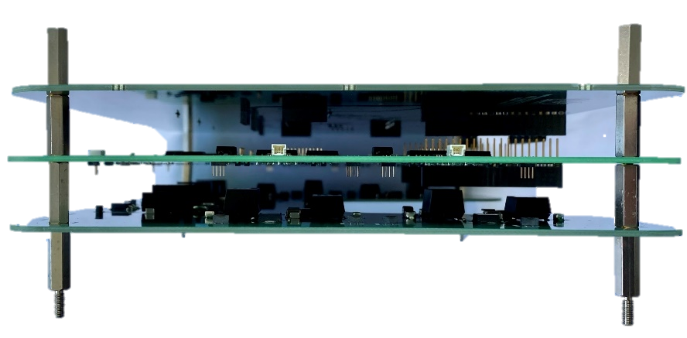
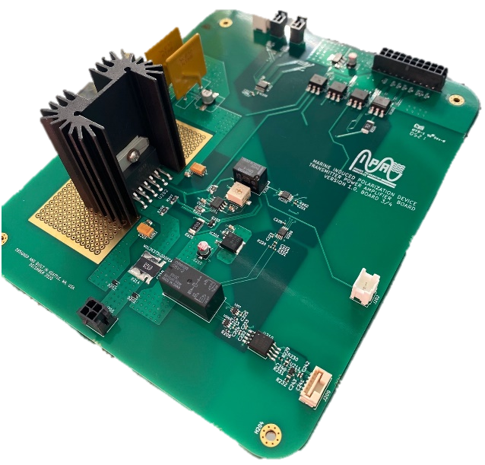

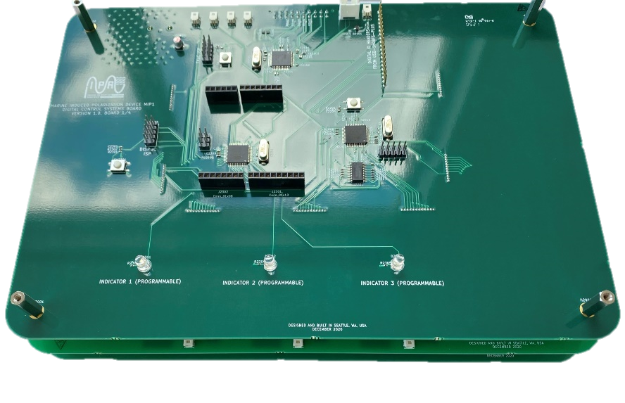
Marine IP: Progress on Milestones
ADAC Annual Meeting: 03 June 2021
  Fabricate prototype: internal boards. Complete
Custom build of electronic boards complete.
Finalized, Compiled Board Design

Slide 19
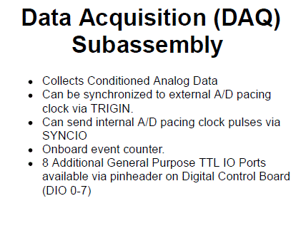
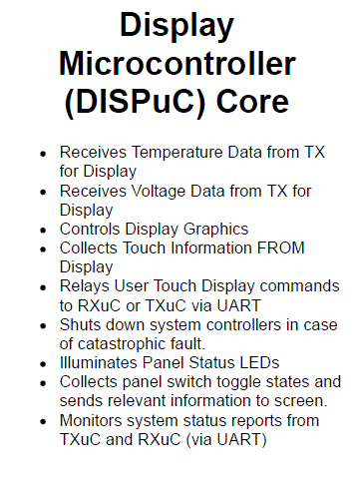
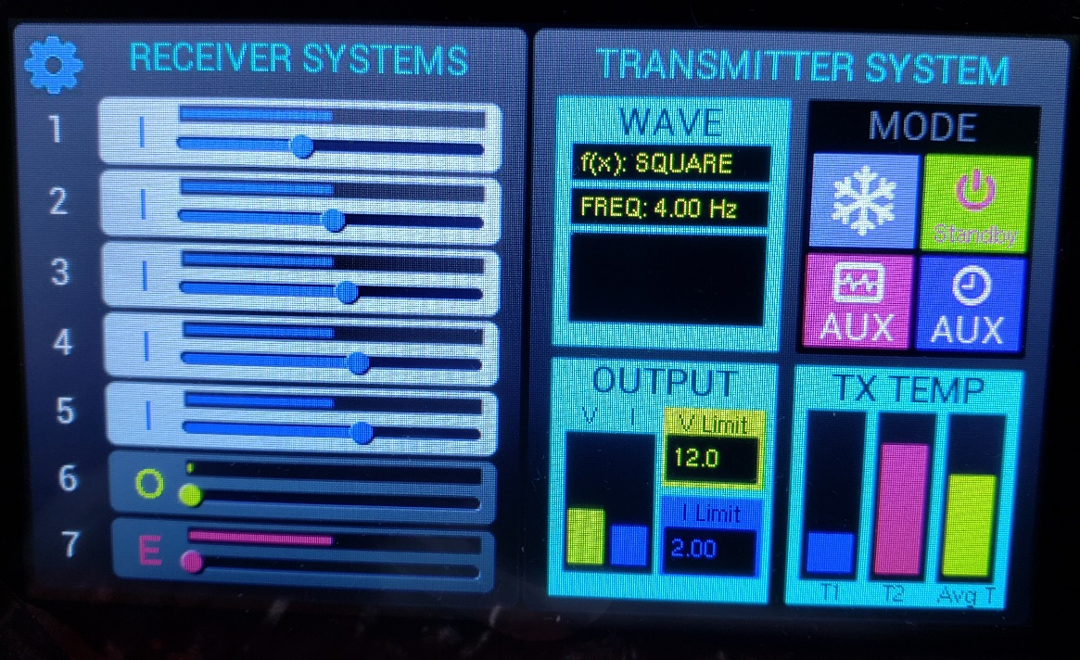
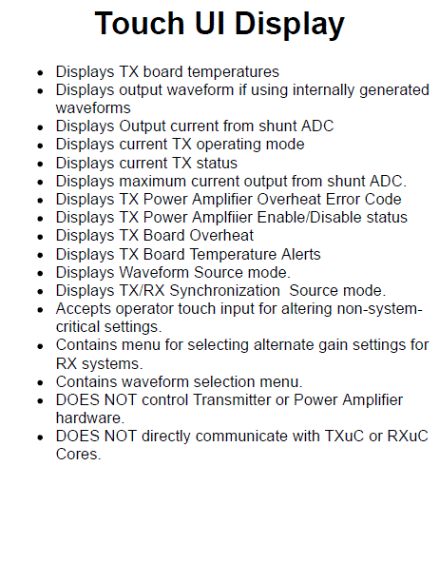
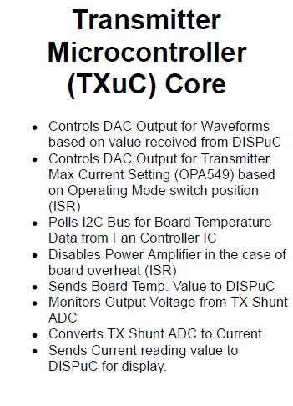
Marine IP: Progress on Milestones
ADAC Annual Meeting: 03 June 2021
Design and write prototype firmware. 80% Complete
  Working to complete Transmitter Microcontroller, Touch UI Display

Slide 20
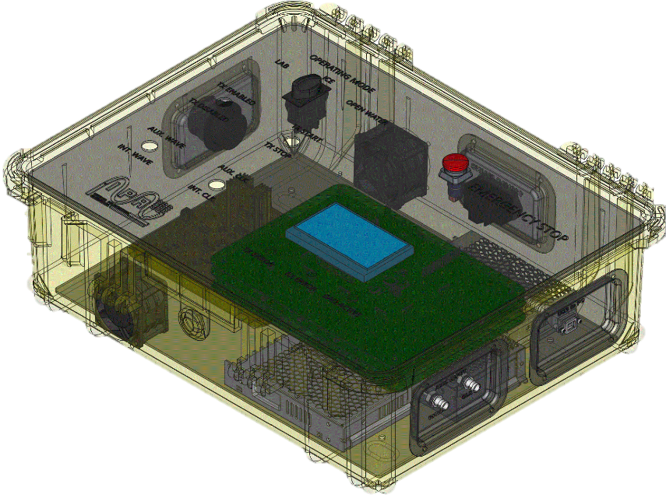
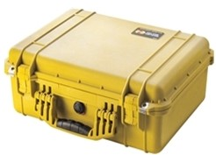
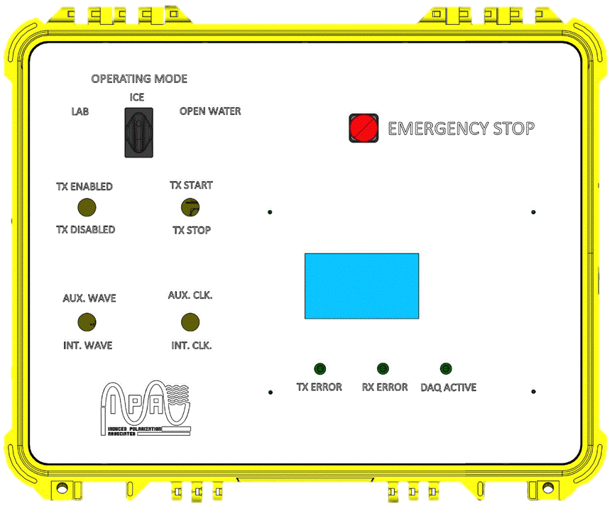
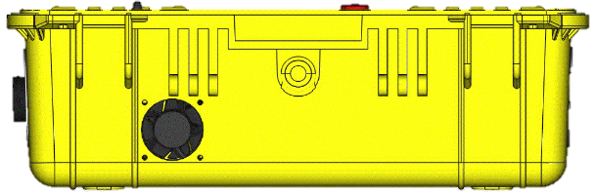
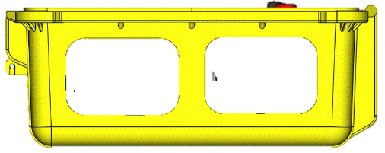
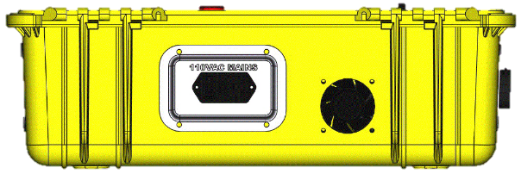
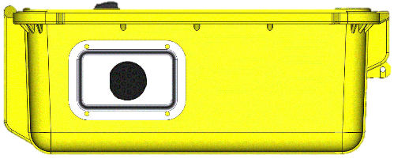
Marine IP: Progress on Milestones
ADAC Annual Meeting: 03 June 2021
  Complete designs for device enclosure and off-board wiring schemes. Complete
Old Enclosure
New Enclosure
12’’
6.9’’
14’’
Interior Interface Layout Design
24’’
18.5’’
24’’
Front Case Exterior
Right Case Exterior
Back Case Exterior
Left Case Exterior

Slide 21
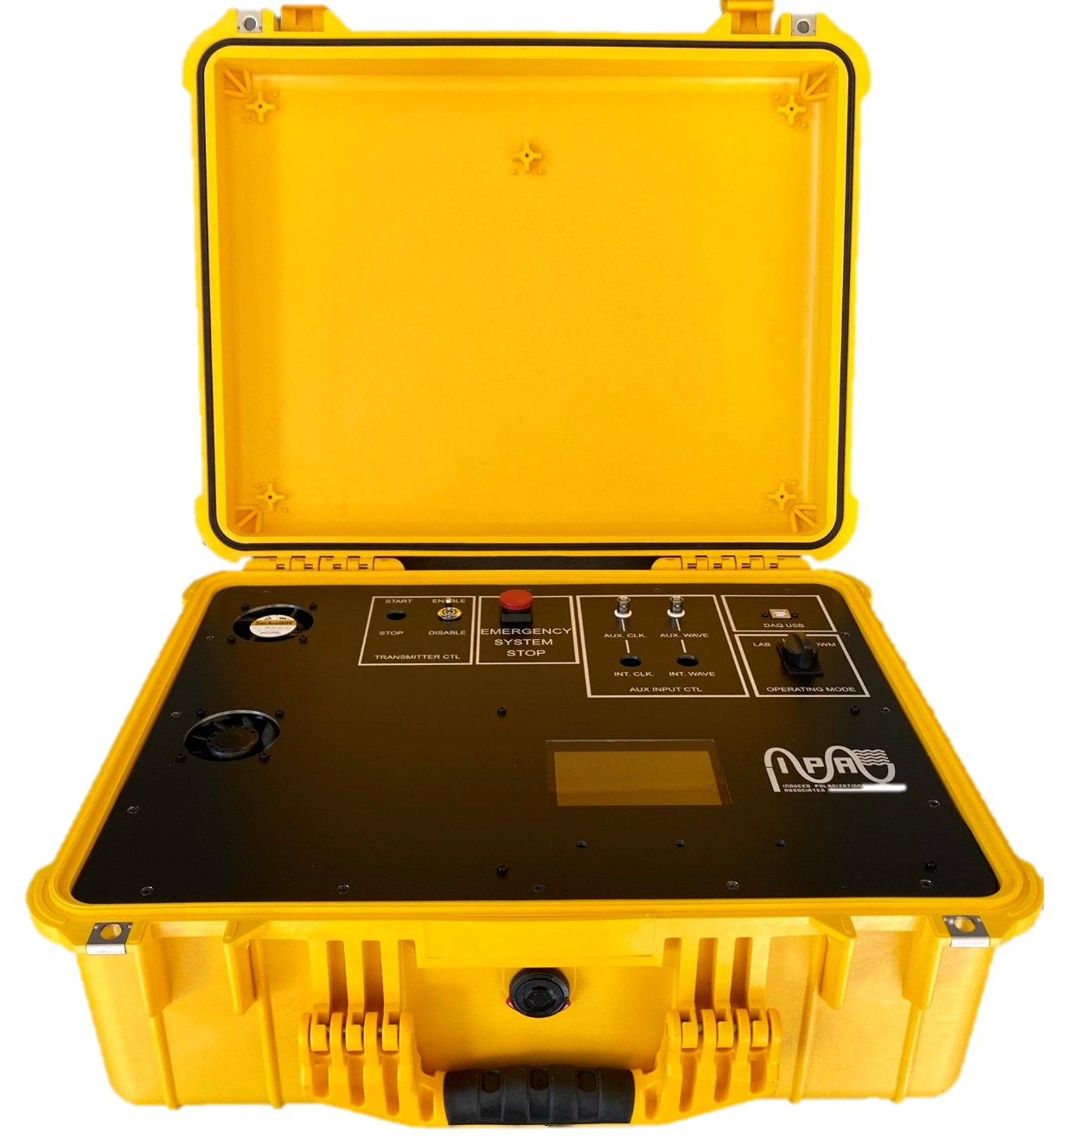
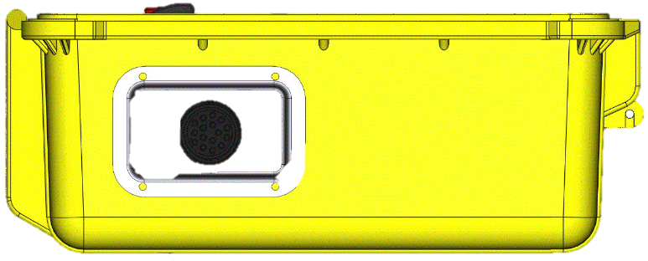

Marine IP: Progress on Milestones
ADAC Annual Meeting: 03 June 2021
  Fabricate prototype. Complete
Design.
Build.

Slide 22



Marine IP: Progress on Milestones
ADAC Annual Meeting: 03 June 2021
New Marine IP Enclosure
  Fabricate prototype. Complete
Marine IP Cable
Laptop
GPS

Slide 23
Marine IP: Progress on Milestones
ADAC Annual Meeting: 03 June 2021
Mock-up a user interface and menu structure. Complete
Submit Field Test Plans for HQ USCG Project Champion review and approval. June 30
Complete mockups of user interfaces and software control systems. June 30
Submit engineering report reviewing design, fabrication methods, construction, and initial performance reviews of hardware system. June 30
Firmware developed and undergoing small-scale laboratory tests and bug fixes. Y8, summer
Startup and initial performance and function tests. Y8, summer Hardware Complete. Pending firmware.
Complete performance and functional tests in laboratory. Y8, summer. Pending firmware.

Slide 24
Marine IP: Progress on Milestones
ADAC Annual Meeting: 03 June 2021
Hardware: Beach testing of device and its integrations with the Marine IP cables. Y8, summer, due to COVID-related board manufacturing delays.
Complete implementation of Arctic-Ready Marine IP System – Hardware, Software. Y8
Complete Field Trials of Arctic-Ready Marine IP System. Y8
Complete data analysis and reporting. Y8

Slide 25
Marine IP: Progress on Outcomes/Outputs
ADAC Annual Meeting: 03 June 2021
  Provide test plan for Arctic-Ready Marine IP System. June 30
Engineering Design Report: Provide advanced information for the design parameters for applications of Marine IP with an autonomous underwater vehicle (AUV). June 30
Arctic-Ready Marine IP System – Hardware: Provide a Marine IP measurement field kit designed for use in arctic conditions. Y8, no-cost extension due to COVID-19.
Arctic-Ready Marine IP System – Software: Provide a new software interface for data collection using the Marine IP measurement field kit. Y8
Technical Report: Provide DHS with a report with all the results of this research that becomes publicly available. Y8, items to follow completion of field work.
Peer-Reviewed Publications: Research team will produce draft peer-reviewed scientific publications from this project. Y8
Publicly Available Data: Researchers (in coordination with ADAC) will ensure all releasable data produced during this project is publicly available within 6 months of project conclusion. Y8

Slide 26
Marine IP: Student Contributions
ADAC Annual Meeting: 03 June 2021
Students did not contribute to this research
One full-time employee and one part-time employee support this project, driving cable design, build, and testing, as well as supporting data processing and analysis

Slide 27
Marine IP: Update on Transition and TRL
ADAC Annual Meeting: 03 June 2021
The goal of this research is to demonstrate Marine IP technology in a relevant environment to enhance situational awareness for the USCG, DHS and other agencies relating to oil released in open or ice-laden water.
Steps to transition:
Demonstration of value and effectiveness for the USCG and other stakeholders through open water and simulated ice environment testing – ADAC Year 6 research.
Development of commercialized equipment, ruggedized for the Arctic environment – ADAC Year 7-8 research.
Develop a software interface suitable for USCG usage – ADAC Year 7-8 research.

Slide 28

Marine IP: Questions?
ADAC Annual Meeting: 03 June 2021
Feedback…
What are we missing?
What can we improve?
Who should we connect with to improve odds of research success?
Project team at CRREL during baseline testing.
From L to R: Karin Messenger (USCG), Scott Socolofsky (TA&M), Dana Tulis (USCG), Alexander Balsley (USCG R&D), Kari Walker (Marine IP), Nathan Lamie (CRREL)

